Slide 1
AXI GPIO
Zynq
Vivado 2015.2 Version

Slide 2
Outline
Introducing AXI GPIO
Configure GPIO IP Instance
GPIO Programming Sequence
SDK Application Development Flow
Application Project Structure
AXI GPIO Driver API
References

Slide 3
AXI GPIO
The AXI (Advanced eXtensible Interface) GPIO design provides a general purpose input/output interface to an AXI4-Lite interface.
The AXI GPIO can be configured as either a single or a dual-channel device.
The width of each channel is independently configurable: 32-bit AXI4-Lite slave.
The ports are configured dynamically for input or output by enabling or disabling the 3-state buffer.
The channels can be configured to generate an interrupt when a transition on any of their inputs occurs.
The GPIO core can be used to control the internal properties of the device as well as the behavior of external devices.

Slide 4
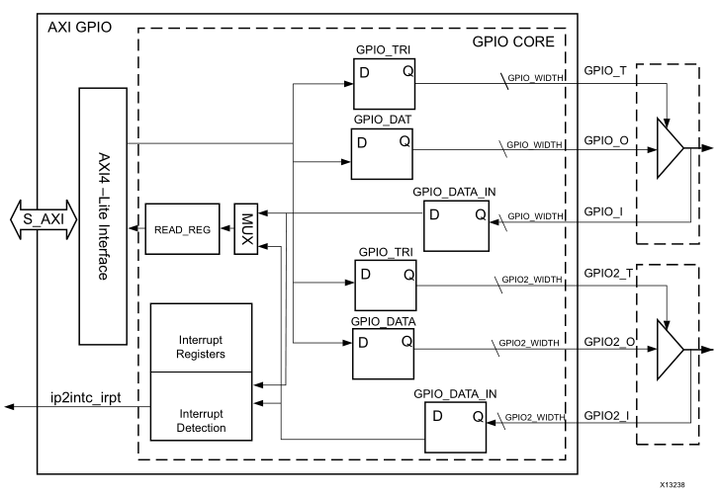
AXI GPIO Block Diagram

Slide 5
Clock and Reset
The AXI GPIO operates on the s_axi_aclk.
The AXI GPIO is reset when s_axi_aresetn is asserted. This is an active-Low reset synchronous to s_axi_aclk clock.

Slide 6
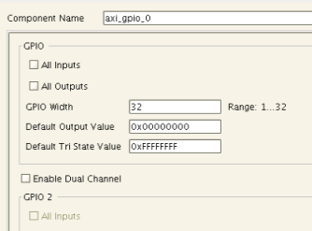
Configure GPIO IP Instance
GPIO Width
Can be from 1 to 32, and default value is 32.
Default Output Value
Sets the default value of all the enabled bits of this channel. By default, this parameter is set to 0x0.
Default Tri State Value
This value configures the input
or output mode of each bit of
GPIO channel. By default, this
field has 0xFFFFFFFF,
configuring all GPIO bits in
input mode.
Notes:
pg144_-axi-gpio.pdf: page 12

Slide 7
Programming Sequence
For input ports when the Interrupt is not enabled, use the following steps:
1. Configure the port as input by writing the corresponding bit in GPIOx_TRI register with the value of 1.
2. Read the corresponding bit in GPIOx_DATA register.
For output ports, use the following steps:
1. Configure the port as output by writing the corresponding bit in GPIOx_TRI register with a value of 0.
2. Write the corresponding bit in GPIOx_DATA register.

Slide 8
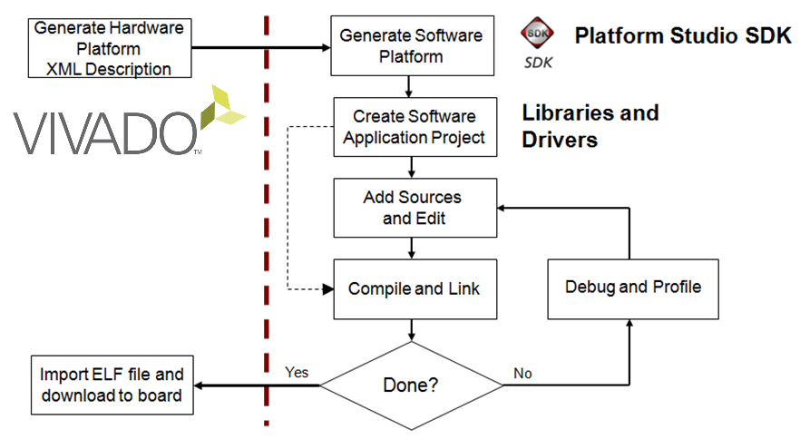
SDK Application Development Flow

Slide 9
Launching SDK From Vivado
Launch SDK
In Vivado
File> Export Hardware
File > Launch SDK
Exporting
A Hardware Description File HDF file is first generated
A hardware platform specification project is then automatically created
The software application (and board support package) then can be created and associated with the hardware platform

Slide 10
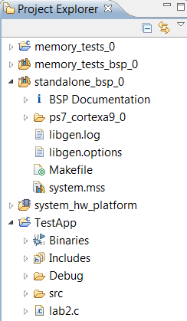
C/C++ Project View
Hierarchical list of the workspace projects in a hierarchical format
Double-click to open a file
Right-click the project to access
its properties
Software Applications
Software BSP
Hardware Description
Software Applications
Notes:
There are three kinds of projects: hardware platform, software Board Support Package (BSP), and software application projects.
There must be at least one hardware platform project workspace.
There must be at least one software board support package project per hardware processor instance.
There can be many software application projects, each one being associated with a BSP project.

Slide 11

Creating a Board Support Package
The Board Support Package provides software services based on the processor and peripherals that make up the processor system
Can be automatically created when creating Application project
Can be created standalone
Must be attached to a Hardware Platform
File > New > Board Support Package
Select appropriate OS support
Third-party operating systems are supported with the appropriate BSP selection
Select required libraries support

Slide 12
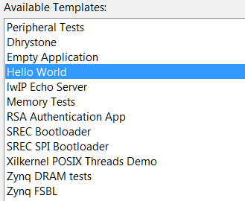
Creating a Software Application Project
SDK supports multiple software application projects
A software project is attached to a BSP project
Sample applications are provided
Great for quick test of hardware
Peripheral Tests
Starting point to base your own application on
Typically an Empty Application is opened to begin a non-standard project

Slide 13
GPIO Driver API
The General Purpose I/O driver resides in the gpio subdirectory.
Details of the layer 1 high level driver can be found in the xgpio.h header file.
Details of the layer 0 low level driver can be found in the xgpio_l.h header file.

Slide 14
gpio.h
This file contains the software API definition of the Xilinx General Purpose I/O (XGpio) device driver component.
The driver provides interrupt management functions. Implementation of interrupt handlers is left to the user.
This driver is intended to be RTOS and processor independent.
Notes:
This file contains the software API definition of the Xilinx General Purpose I/O (XGpio) device driver
component.
The Xilinx GPIO controller is a soft IP core designed for Xilinx FPGAs on the OPB or PLB bus and
contains the following general features:
l Support for up to 32 I/O discretes for each channel (64 bits total).
l Each of the discretes can be configured for input or output.
l Configurable support for dual channels and interrupt generation.
The driver provides interrupt management functions. Implementation of interrupt handlers is left to the
user. Refer to the provided interrupt example in the examples directory for details.
This driver is intended to be RTOS and processor independent. Any needs for dynamic memory
management, threads or thread mutual exclusion, virtual memory, or cache control must be satisfied by
the layer above this driver.
Note:
This API utilizes 32 bit I/O to the GPIO registers. With less than 32 bits, the unused bits from
registers are read as zero and written as don't cares.

Slide 15
Data Structure
There are two data structures used in gpio component:
Xgpio
Xgpio_Config
Both are defined in gpio.h

Slide 16
Data Structures - Xgpio
struct Xgpio typedef struct {
u32 BaseAddress; /* Device base address */
u32 IsReady; /* Device is initialized and ready */
int InterruptPresent; /* Are interrupts supported in h/w */
int IsDual; /* Are 2 channels supported in h/w */
} XGpio;
The XGpio driver instance data.
The user is required to allocate a variable of this type for every GPIO device in the system.
A pointer to a variable of this type is then passed to the driver API functions.

Slide 17
Data Structures – Xgpio_Config
struct Xgpio_Config typedef struct {
u16 DeviceId; /* Unique ID of device */
u32 BaseAddress; /* Device base address */
int InterruptPresent; /* Are interrupts supported in h/w */
int IsDual; /* Are 2 channels supported in h/w */
} XGpio_Config;
This typedef contains configuration information for the device.

Slide 18
XGpio_Initialize
int XGpio_Initialize ( XGpio *InstancePtr, u16 DeviceId )
Initialize the XGpio instance provided by the caller based on the given DeviceID.
Parameters:
InstancePtr is a pointer to an XGpio instance. The memory the pointer references must be pre-allocated by the caller. Further calls to manipulate the component through the XGpio API must be made with this pointer.
DeviceId is the unique id of the device controlled by this XGpio component. Passing in a device id associates the generic XGpio instance to a specific device, as chosen by the caller or application developer.
Returns:
XST_SUCCESS Initialization was successful.
XST_DEVICE_NOT_FOUND if the device configuration data was not found for a device with the supplied device ID.
Example:
XGpio dip;
XGpio_Initialize(&dip, XPAR_SWITCHES_DEVICE_ID);

Slide 19
XGpio_SetDataDirection
void XGpio_SetDataDirection (XGpio *InstancePtr,
unsigned Channel,
u32 DirectionMask);
Set the input/output direction of all discrete signals for the specified GPIO channel.
Parameters:
InstancePtr is a pointer to an XGpio instance to be worked on.
Channel contains the channel of the GPIO (1 or 2) to operate on.
DirectionMask is a bitmask specifying which discretes are input and which are output. Bits set to 0 are output and bits set to 1 are input.
Example:
XGpio_SetDataDirection(&dip, 1, 0xffffffff); // set direction to input.
Notes:
void
XGpio_SetDataDirection
( XGpio *
InstancePtr,
unsigned Channel,
Xuint32 DirectionMask
)
Set the input/output direction of all discrete signals for the specified GPIO channel.
Parameters:
InstancePtr is a pointer to an XGpio instance to be worked on.
Channel contains the channel of the GPIO (1 or 2) to operate on.
DirectionMask is a bitmask specifying which discretes are input and which are output. Bits
set to 0 are output and bits set to 1 are input.
Returns:
None.
Note:
The hardware must be built for dual channels if this function is used with any channel other
than 1. If it is not, this function will assert.

Slide 20
XGpio_DiscreteWrite
void XGpio_DiscreteWrite (XGpio *InstancePtr,
unsigned Channel,
u32 Data);
Write to discrete register for the specified GPIO channel.
Parameters:
InstancePtr is a pointer to an XGpio instance to be worked on.
Channel contains the channel of the GPIO (1 or 2) to operate on.
Data is the value to be written to the discrete register.
Example:
XGpio led;
u32 data=1;
…
XGpio_DiscreteWrite(&led, 1, data);
Notes:
void
XGpio_DiscreteWrite
( XGpio *
InstancePtr,
unsigned Channel,
Xuint32 Data
)
Write to discretes register for the specified GPIO channel.
Parameters:
InstancePtr is a pointer to an XGpio instance to be worked on.
Channel contains the channel of the GPIO (1 or 2) to operate
on.
Data is the value to be written to the discretes register.
Returns:
None.
Note:
The hardware must be built for dual channels if this function is used with any channel other
than 1. If it is not, this function will assert. See also XGpio_DiscreteSet() and
XGpio_DiscreteClear().

Slide 21
XGpio_DiscreteRead
u32 XGpio_DiscreteRead (XGpio *InstancePtr,
unsigned Channel);
Read state of discretes for the specified GPIO channnel.
Parameters:
InstancePtr is a pointer to an XGpio instance to be worked on.
Channel contains the channel of the GPIO to operate on.
Returns:
Current copy of the discretes register.
Example:
XGpio push;
int psb_check;
…
psb_check = XGpio_DiscreteRead(&push, 1);

Slide 22
AXI GPIO Driver Calling Sequence
XGpio_Initialize
XGpio_SetDataDirection
XGpio_DiscreteRead / XGpio_DiscreteWrite

Slide 23
References
AXI GPIO – pg144-axi-gpio.pdf: To find this document, In Vivado IP Integrator, open IP Catalog→select AXI GPIO→right click AXI GPIO, select Product Guide.
Software API for AXI GPIO:
In SDK, after your project is created, open system.mss file, in peripheral driver session, find any instant of GPIO, click documentation. You will find the API document in the following directory: “VivadoDirectory”/data/embeddedsw/XilinxProcessorIPLib/drivers/gpio_v4_0/doc/html/api/index.html

